Slide 1

Whack-a-Mole
By Mitko Georgiev

Slide 2

What is it?
Its an arcade game developed in 1975 in which players use a mallet to hit moles which appear at random and hide back into their holes.
Note:
Whack-a-Mole is a game. I do not, in any way, shape, or form, condone animal cruelty.

Slide 3
Design specifications
The game starts with a 20 seconds countdown timer
The player must click the appropriate switch corresponding to the LED
LEDs represent the moles (16 LEDs)
Switches represent the hammer to whack the mole with (16 Switches)
Once the player hits the correct switch the score will go up by one
If the player misses the score will remain the same and a new LED will light up
Once the timer reaches zero the game is over
It only restarts if the reset button is pressed

Slide 4
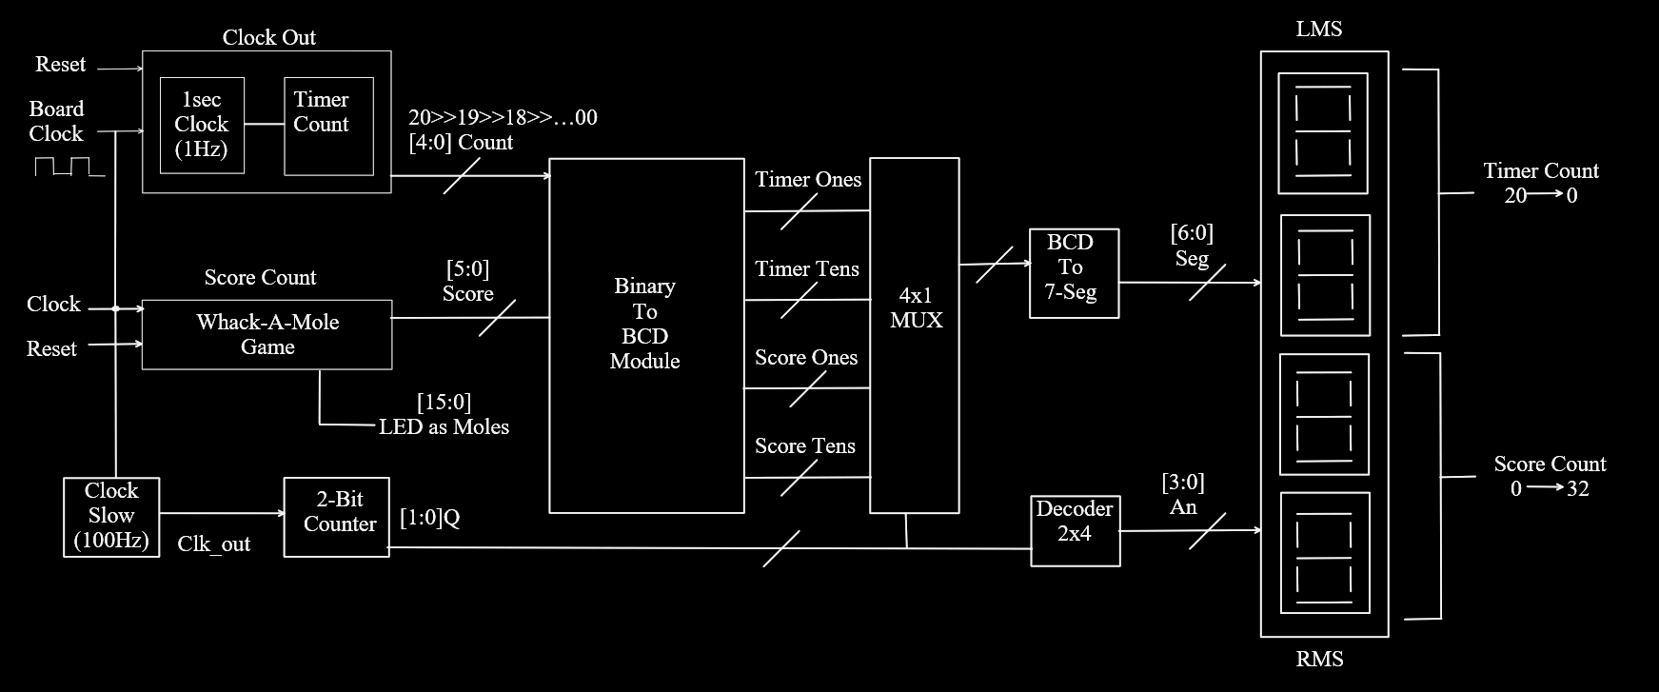
Block diagram

Slide 5
Schematic

Slide 6
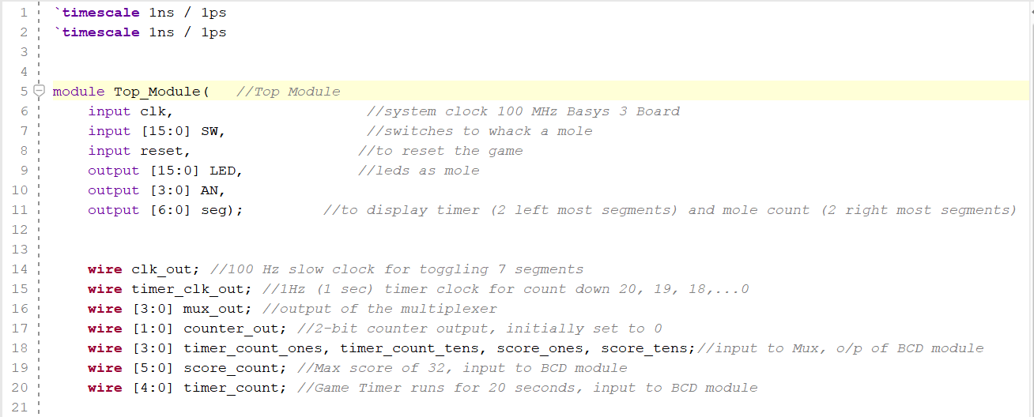
Top module

Slide 7
Clock out - block
What it does:
Turns the fast board clock into a slower 1-second clock.
Keeps track of time starting from 20 seconds and counts down to 0.
Why it’s important:
This block controls the game timer, so you know how much time is left to play.

Slide 8
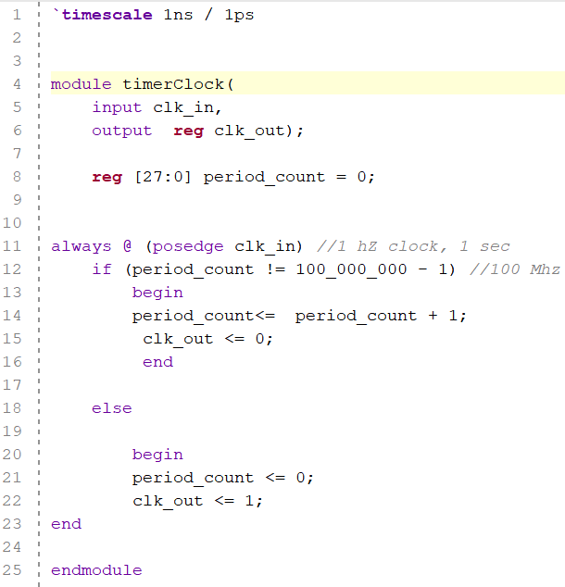
Timer clock (fast)

Slide 9
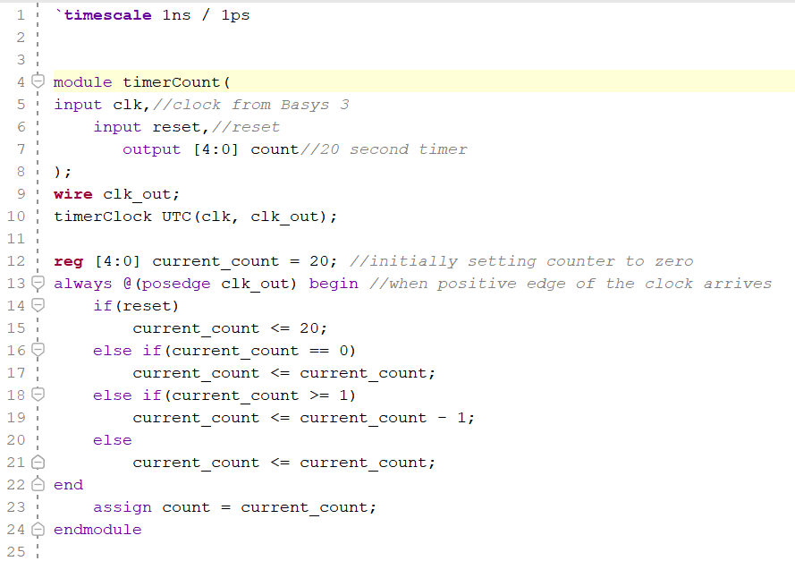
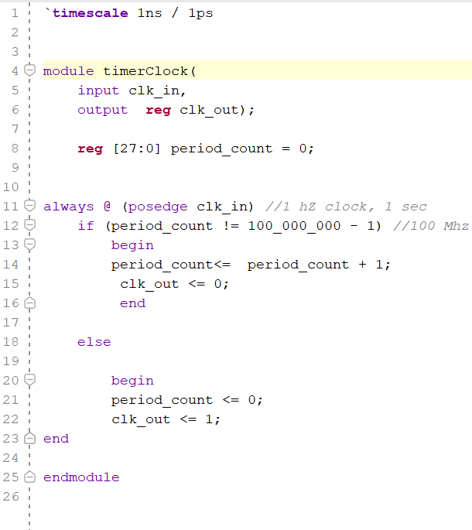
Timer count and timer clock

Slide 10
Whack-a-Mole Game Block
What it does:
Lights up random LEDs (the "moles").
Tracks how many moles the player "whacks" by pressing a button.
Updates the player’s score.
Why it’s important:
This is the core of the game—it runs the "whack-a-mole" logic!

Slide 11
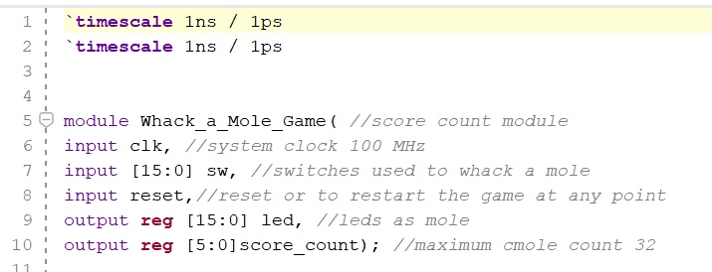
Whack a mole game

Slide 12
Clock Slow and 2-Bit Counter
Clock Slow Block:
Slows down the board clock to 100Hz, which is better for controlling the moles.
2-Bit Counter:
Cycles through 4 states [0:3]
Helps switch between the displays one at a time.
Used to manage sequential mole activation and display multiplexing.

Slide 13

Truth Table for 2-Bit Counter
Clock Cycle | Q1 (MSB) | Q0 (LSB)
0 | 0 | 0
1 | 0 | 1
2 | 1 | 0
3 | 1 | 1
4 (Repeat) | 0 | 0
The 2-bit counter cycles through four states (00, 01, 10, 11) and is used for display multiplexing or mole activation.

Slide 14
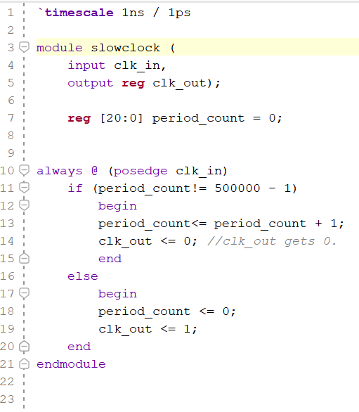
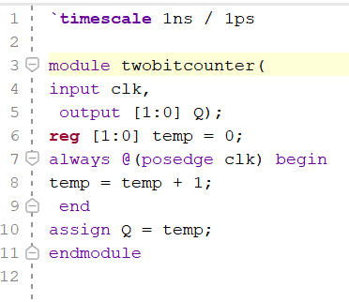
Slow clock and Two-bit counter

Slide 15
Binary to BCD Module
What it does:
Converts numbers from binary (how computers count) to decimal
(what we understand).
Why it’s important:
Makes the score and timer easy to display on the screen.

Slide 16
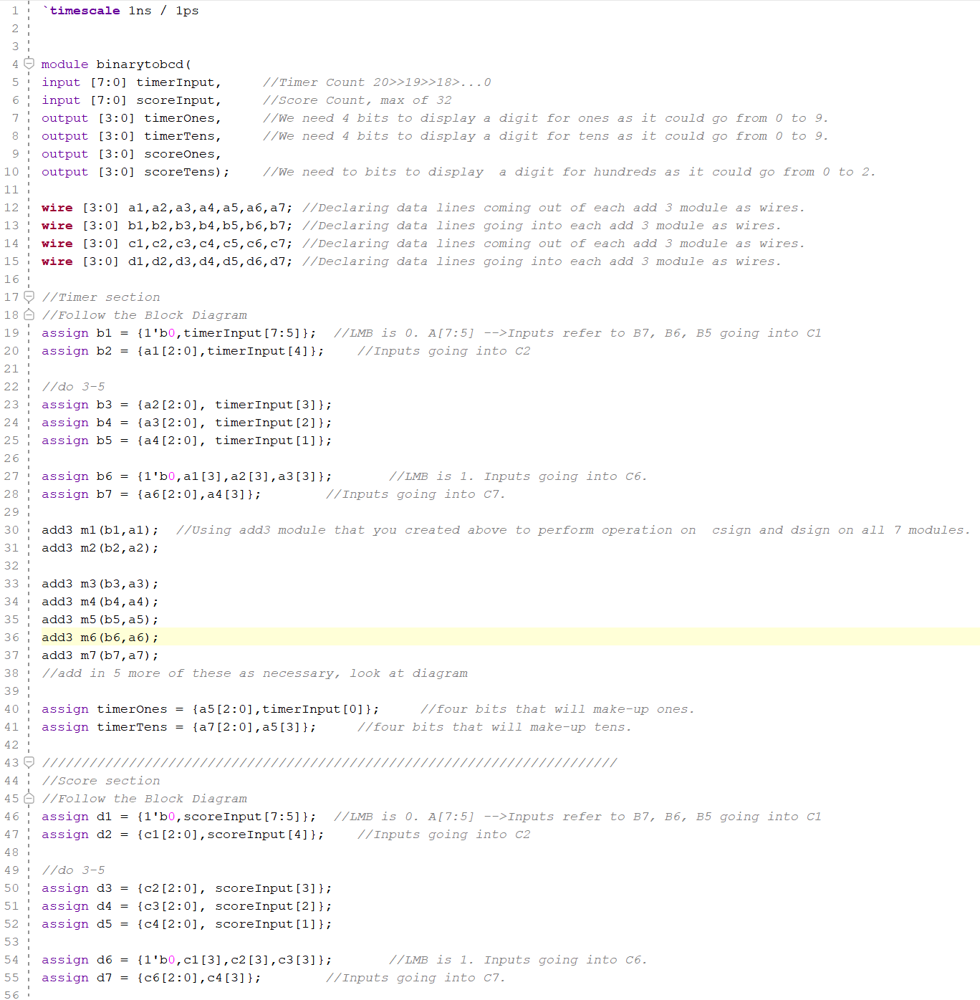
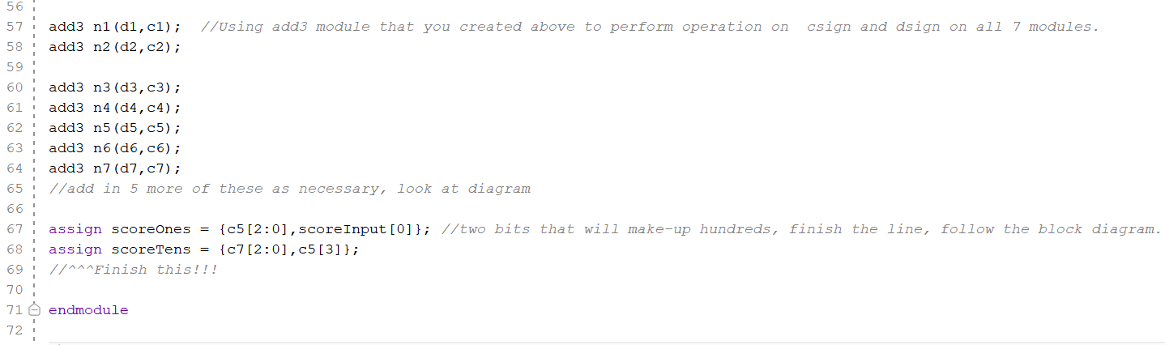
Binary to bcd

Slide 17
4x1 Multiplexer
What it does:
Chooses one number to send to the display at a time
(timer ones, timer tens, score ones, or score tens).
Why it’s important:
It helps the system handle multiple numbers without needing extra wires or circuits.

Slide 18
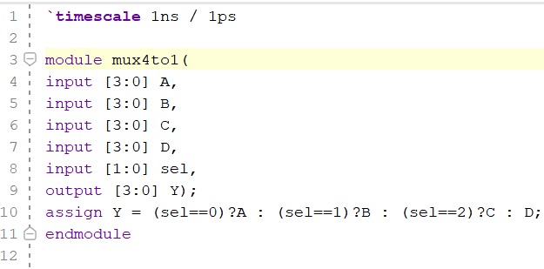
MUX 4:1

Slide 19
2x4 Decoder
What it does:
Picks which of the 4 displays to light up at any moment.
Why it’s important:
It lets us use just one set of signals to control all the displays (multiplexing).

Slide 20
Truth Table for 2x4 Decoder
The 2x4 decoder takes the 2-bit counter output and activates one of the four 7-segment displays (anodes).
Input (Q1 Q0) | Output (An3) | Output (An2) | Output (An1) | Output (An0)
0 | 1 | 0 | 0 | 0
1 | 0 | 1 | 0 | 0
10 | 0 | 0 | 1 | 0
11 | 0 | 0 | 0 | 1

Slide 21
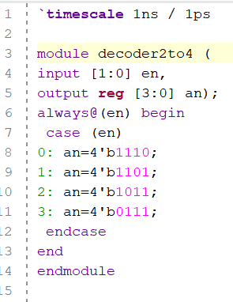
Decoder 2:4

Slide 22
BCD to 7-Segment Decoder
What it does:
Converts the decimal number into signals to light up specific parts of the
7-segment display.
Why it’s important:
Turns the numbers into something we can see on the screen.

Slide 23
7-Segment Displays
What it does:
Two displays show the timer (how much time is left).
Two displays show the score (how many moles you’ve whacked).
Why it’s important:
It gives the player real-time feedback about their performance.

Slide 24
Truth Table for BCD-to-7-Segment Decoder
BCD Input | A | B | C | D | E | F | G | Displayed Digit
0000 (0) | 1 | 1 | 1 | 1 | 1 | 1 | 0 | 0
0001 (1) | 0 | 1 | 1 | 0 | 0 | 0 | 0 | 1
0010 (2) | 1 | 1 | 0 | 1 | 1 | 0 | 1 | 2
0011 (3) | 1 | 1 | 1 | 1 | 0 | 0 | 1 | 3
0100 (4) | 0 | 1 | 1 | 0 | 0 | 1 | 1 | 4
0101 (5) | 1 | 0 | 1 | 1 | 0 | 1 | 1 | 5
0110 (6) | 1 | 0 | 1 | 1 | 1 | 1 | 1 | 6
0111 (7) | 1 | 1 | 1 | 0 | 0 | 0 | 0 | 7
1000 (8) | 1 | 1 | 1 | 1 | 1 | 1 | 1 | 8
1001 (9) | 1 | 1 | 1 | 1 | 0 | 1 | 1 | 9
The BCD-to-7-segment decoder converts a BCD input into control signals for the segments (A-G) of a 7-segment display.

Slide 25
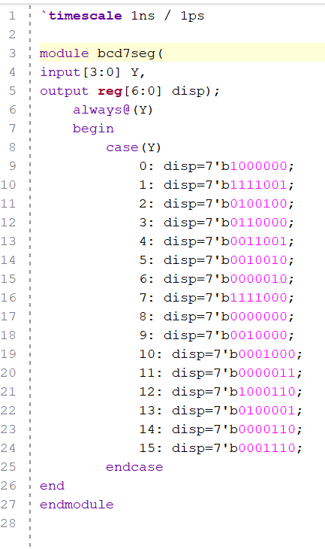
Bcd to 7 seg displays

Slide 26
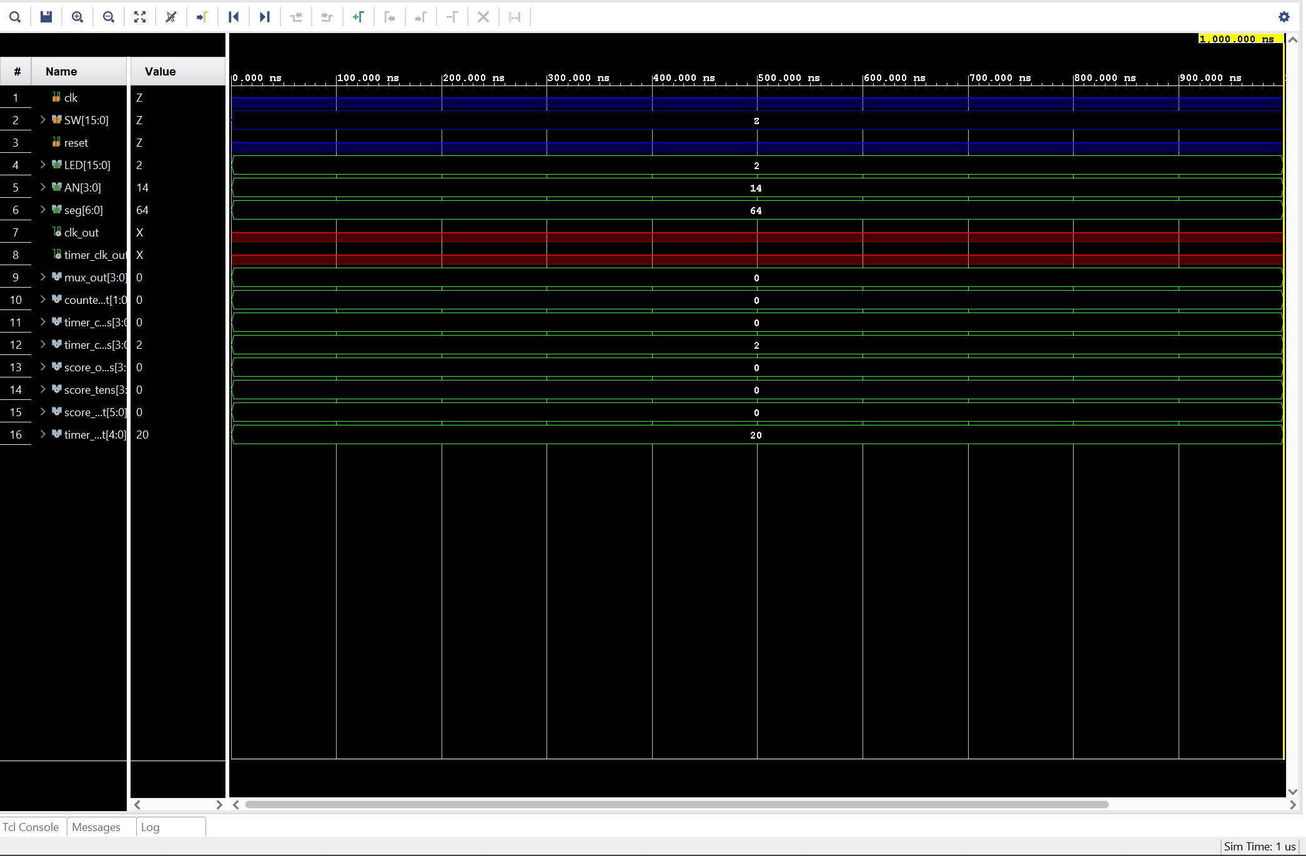
Simulation

Slide 27
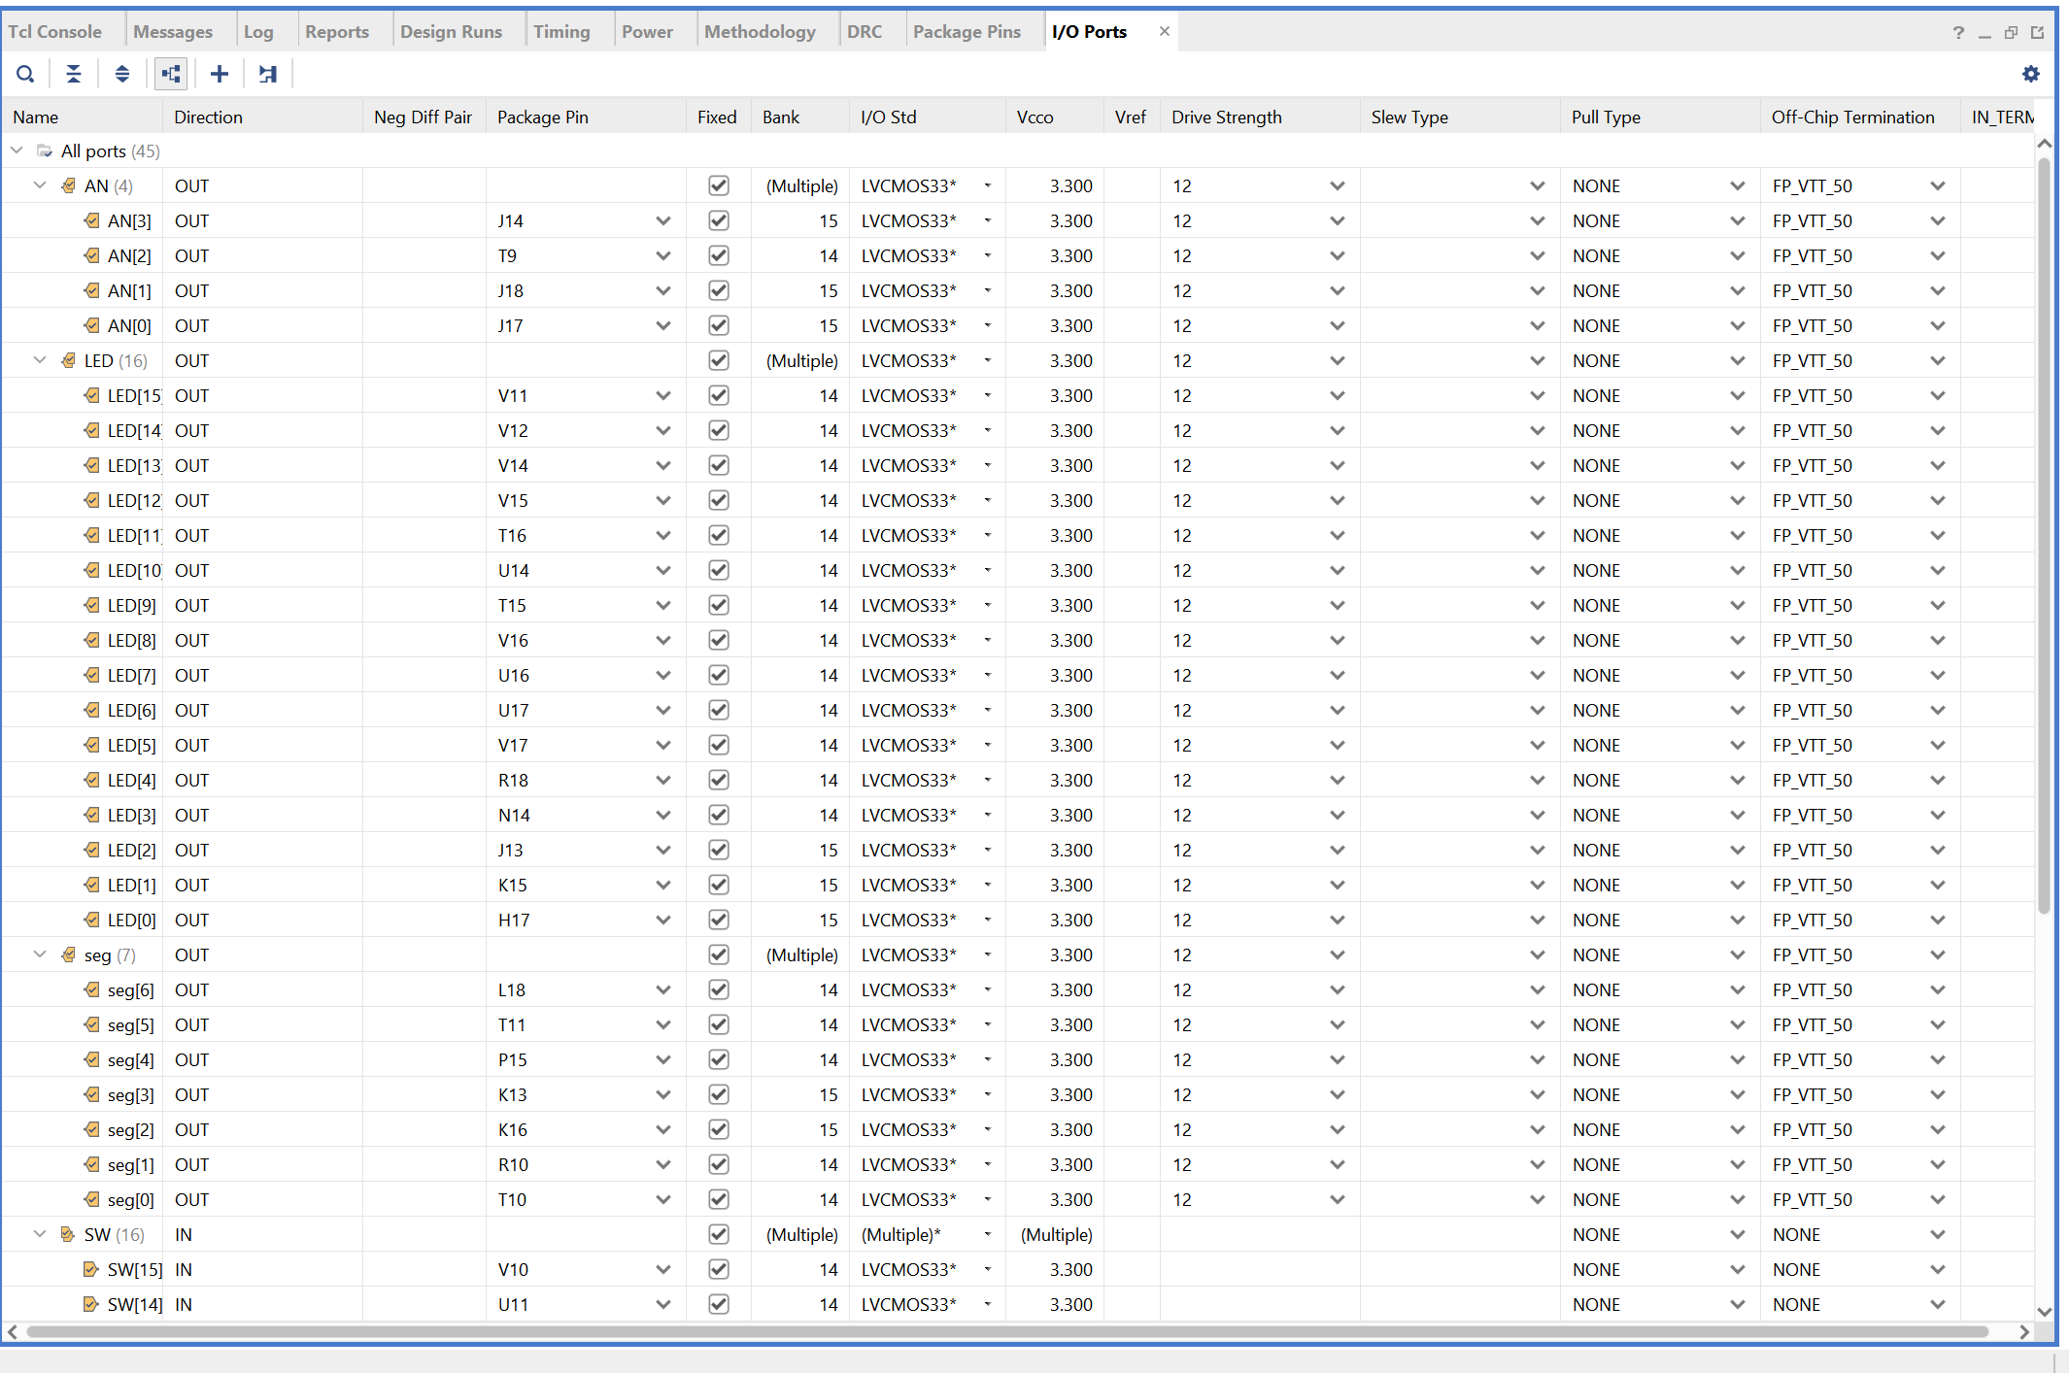
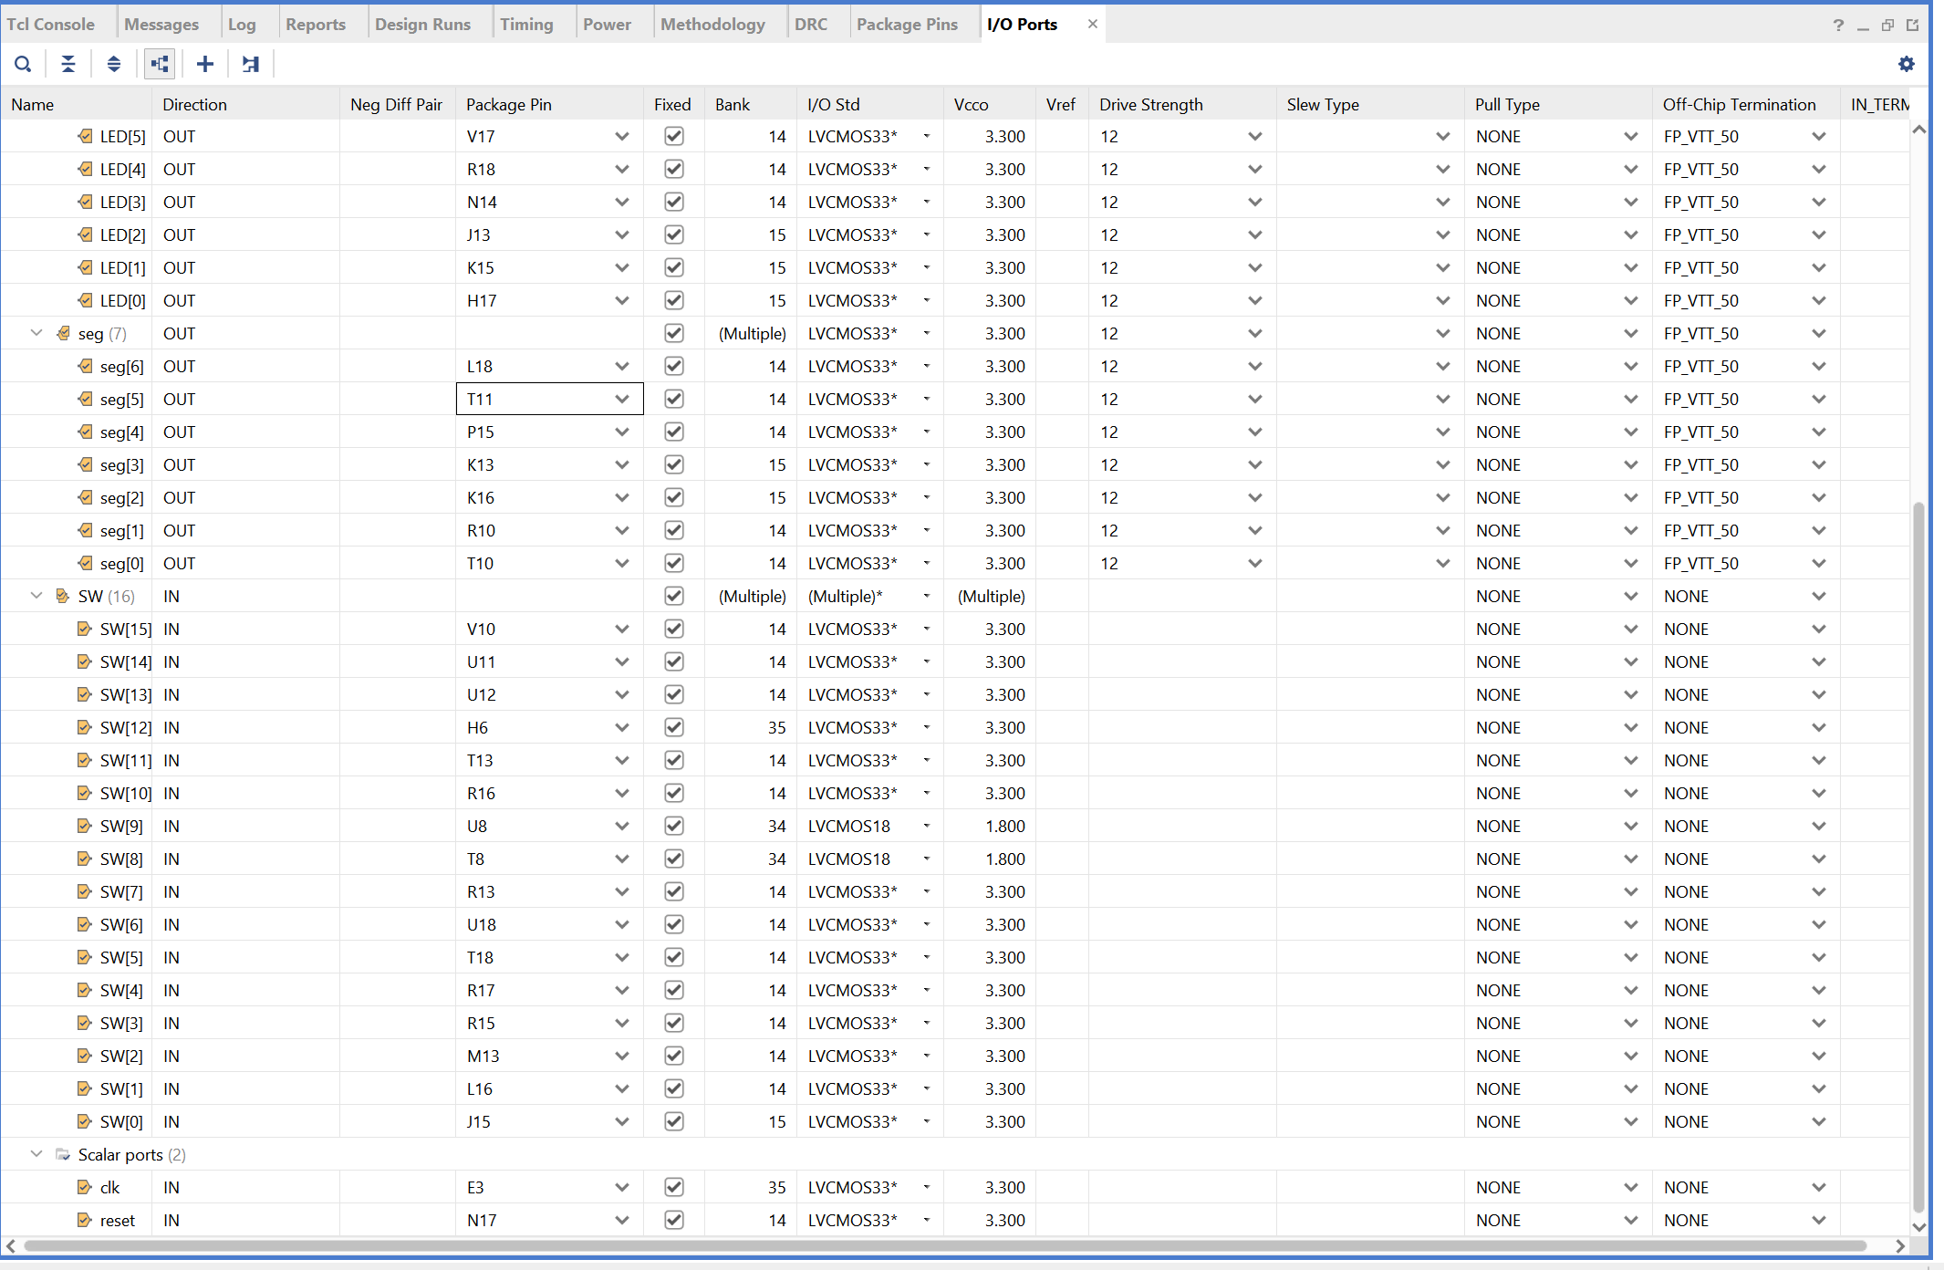
Pin Connections

Slide 28
Final Thoughts
What we built:
A simple hardware game with a timer, a score tracker, and a fun way to play.
What we learned:
How to use clocks, counters, multiplexers, and displays to build a working system.
What could be next:
Add more moles, make the game faster, or even add difficulty levels!

Slide 29
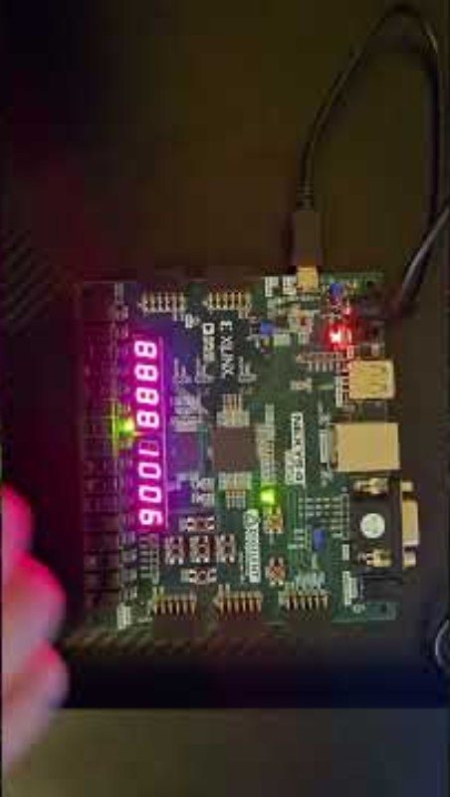
GAME VIDEO

Slide 30
THE END THANK YOU!!

